Slide 1
Electron Cutout Factors

Slide 2
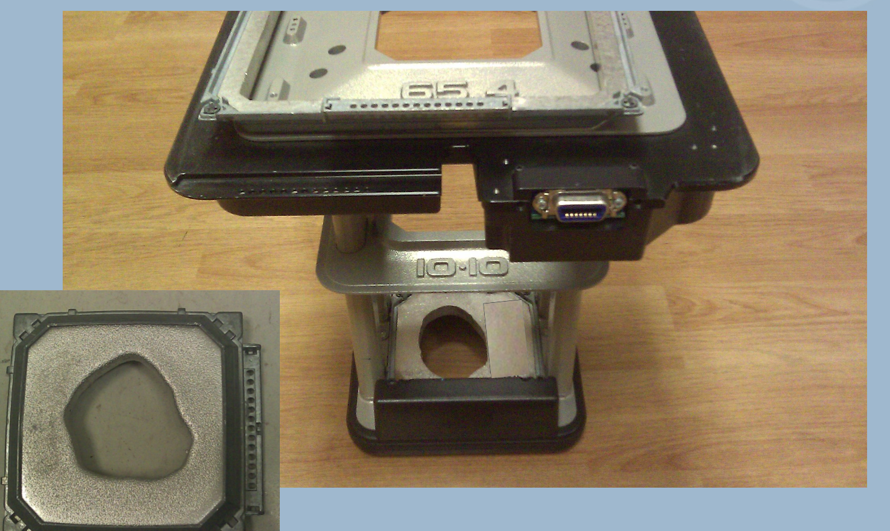
How do you measure electron cutout factors?

Slide 3

Electron cutout factor
How do you perform an electron MU calculation?
D₀’ = 1cGy/MU at dmax, 100cm SSD, 10x10cm cone
S_{e} = cone factor and cutout factor combined
ISL Factor is last term, where g is the gap between the treatment SSD and calibration SSD, and SSD_{eff} is the effective SSD for the given cone size

Slide 4
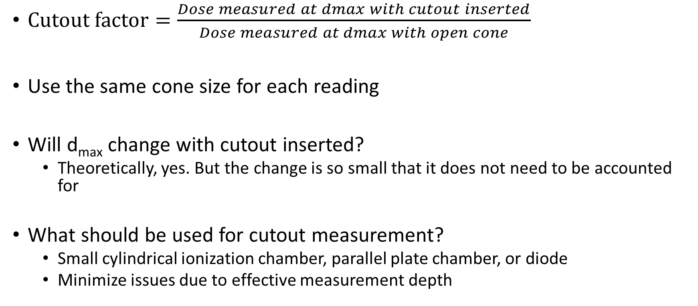
Electron cutout factor
$Cutout factor=\frac{Dose measured at dmax with cutout inserted}{Dose measured at dmax with open cone}$
Use the same cone size for each reading
Will d_{max} change with cutout inserted?
Theoretically, yes. But the change is so small that it does not need to be accounted for
What should be used for cutout measurement?
Small cylindrical ionization chamber, parallel plate chamber, or diode
Minimize issues due to effective measurement depth

Slide 5
How are electron cutout factors handled at PCAM?
Lookup table for many circular, square, and rectangular cutouts
We will typically measure electron cutout factors for cutouts that:
Have irregular shape
Have large disagreement between Radcalc and PennMU
Have a dimension that is smaller than the electron range being used
Why?
Lack of lateral scatter equilibrium

Slide 6
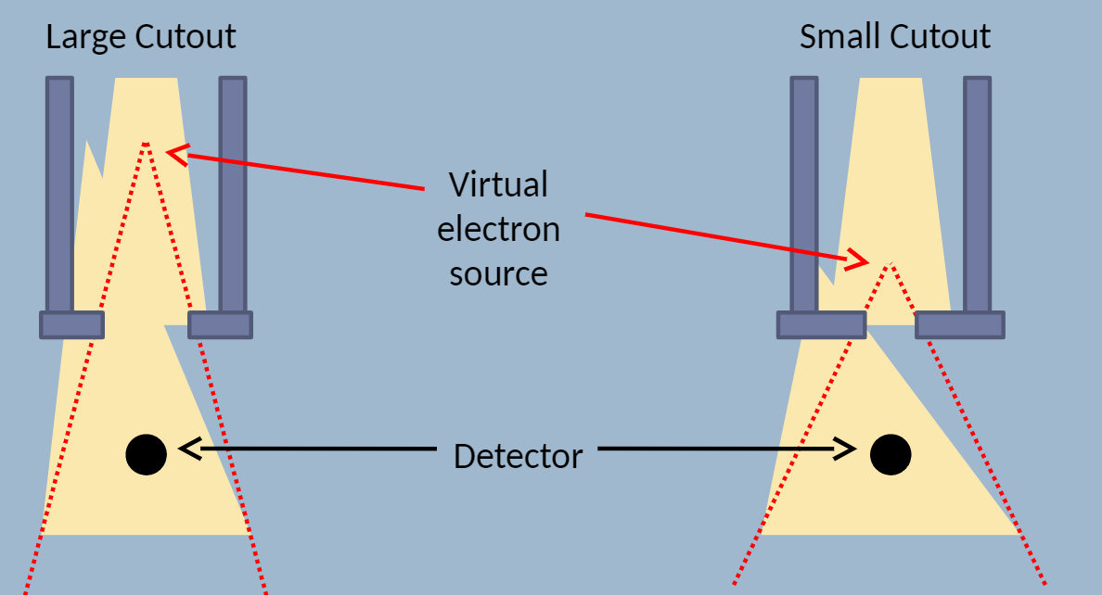
Does cutout factor change when SSD is changed?
Yes
Why?
Each cutout creates a different virtual source position and, therefore, divergence
At extended SSD, the relative output decreases faster for smaller cutouts

Slide 7
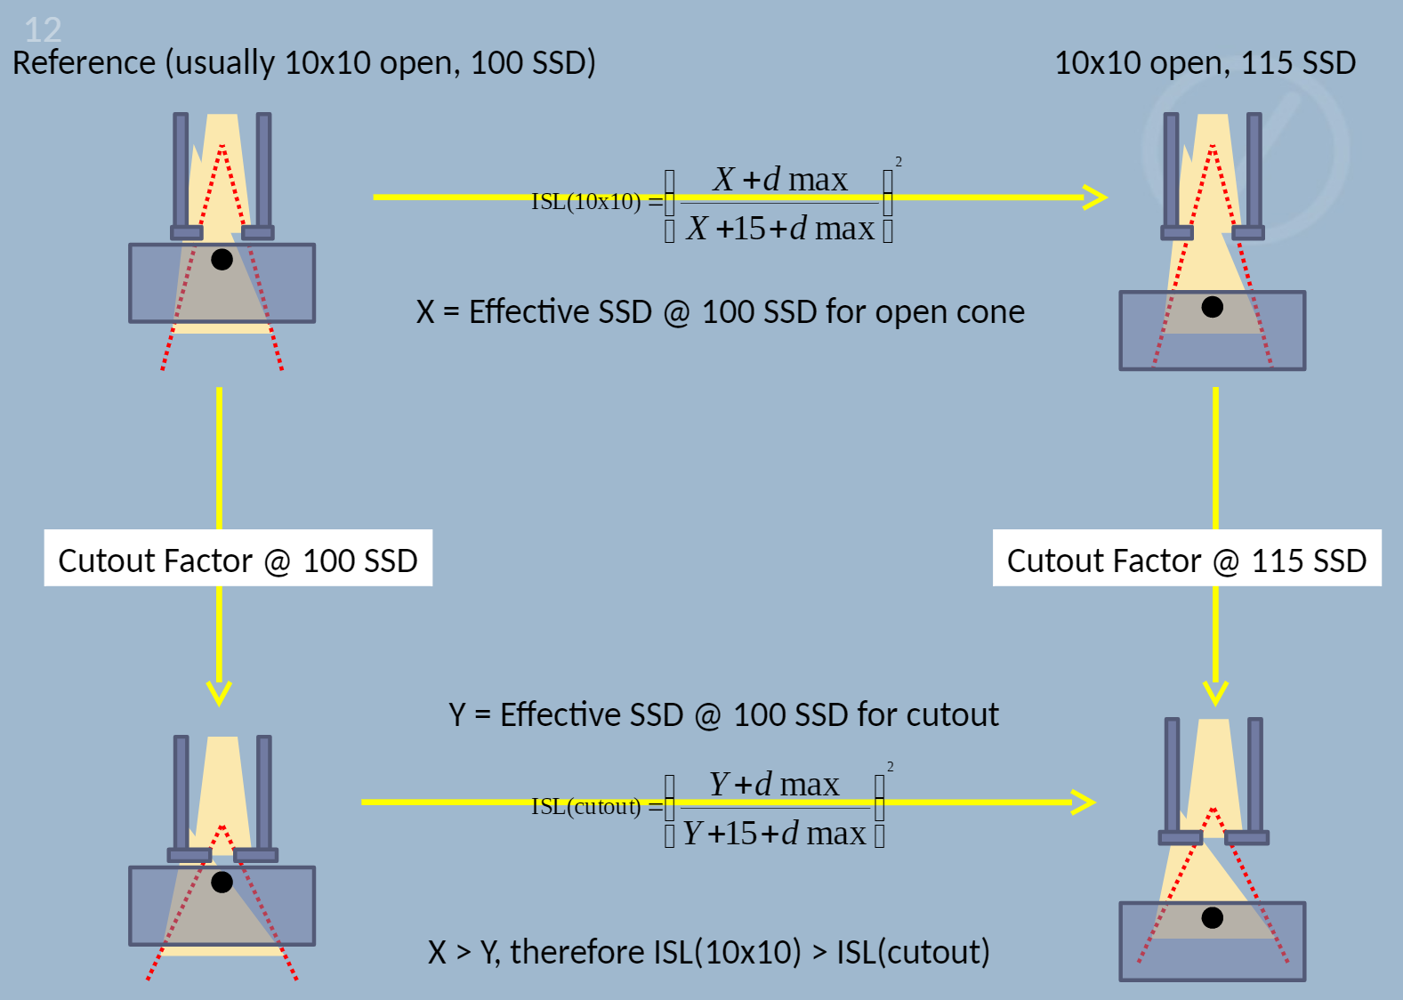
Converting cutout factor at SSD₁ → SSD₂

Slide 8
Can cutout factor be greater than 1?
Yes
Why?
Detector reading = Direct radiation + Head scatter radiation
Direct radiation = Primary beam + phantom scatter hitting detector
Head scatter radiation = Scatter from jaws, MLC, electron applicator, electron cutout
Direct contribution always increases with increasing cutout
Head scatter contribution depends on the energy and range of scattered particles
Electron-electron scattering is mostly at large angles (compared to photon-electron scattering which is mostly forward)
Scattered particles reaching the detector are mostly from the inner edge of the cutout

Slide 9
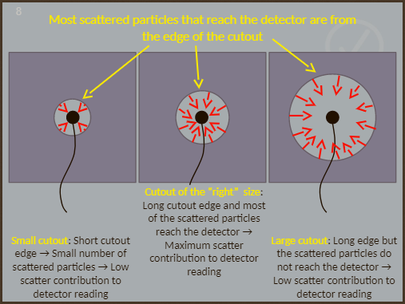
Can cutout factor be greater than 1?

Slide 10
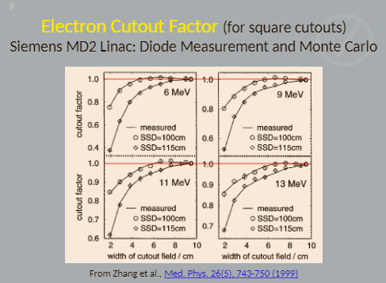
Can cutout factor be greater than 1?

Slide 11
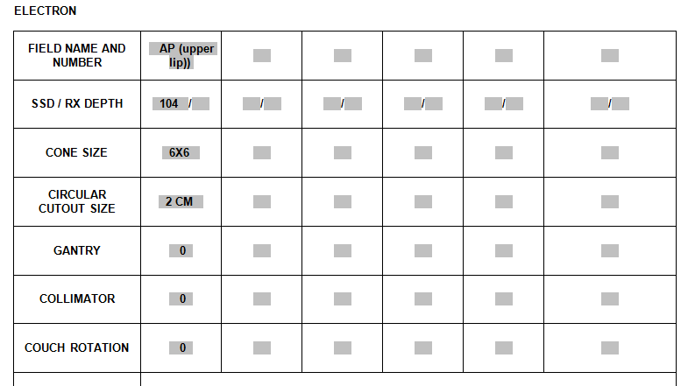
Clinical example

Slide 12
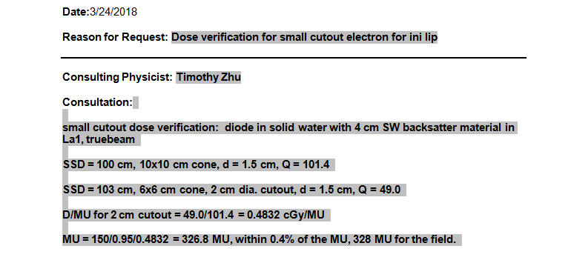
Clinical example

